Slide 1

Enhancing Search Engine Relevance for Video Subtitles
Leveraging Natural Language Processing and Machine Learning Techniques
MADDELA RAVITEJA
B Aravinth
Team ID: T211078

Slide 2
Background :
Scenario:
Imagine the frustration of searching for a specific scene in a movie and not finding it. That's the challenge we're tackling head-on.
Example:
You're trying to find the scene where the protagonist proposes, but all you get are irrelevant results.
Insight:
We believe effective search engines are the bridge between users and valuable content in today's digital world.

Slide 3
Objective:
Purpose:
Our goal is to build a search engine that understands not just keywords but the context and meaning behind every search query.
Example:
You search for "heartwarming moments" and instantly find touching scenes from your favorite films.
Insight:
By harnessing the power of AI, we aim to enhance search accuracy and relevance to new heights.

Slide 4
Keyword Based vs Semantic Search Engines:
Comparison:
Let's contrast traditional keyword-based search engines with modern semantic ones.
Example:
With a keyword engine, searching "fast cars" might yield generic results, while a semantic engine understands you're looking for thrilling racing scenes.
Insight:
Semantic engines provide more nuanced and relevant search results by grasping the deeper meaning behind queries.

Slide 5
Core Logic:
Process Overview:
We follow a meticulous process of cleaning, organizing, and comparing subtitle data to ensure accurate retrieval.
Example:
We clean up subtitle files, remove timestamps, and compare user query vectors to subtitle vectors.
Insight:
Through preprocessing and cosine similarity calculations, we guarantee precise search results tailored to each user.

Slide 6
Step by Step Process - Part 1:
Document Ingestion:
We start by decoding and cleaning subtitle data, preparing it for analysis.
Example:
Extracting text from subtitle files, removing unnecessary noise, and organizing the data for efficient processing.
Insight:
We experiment with various text vectorization techniques to optimize search performance.

Slide 7
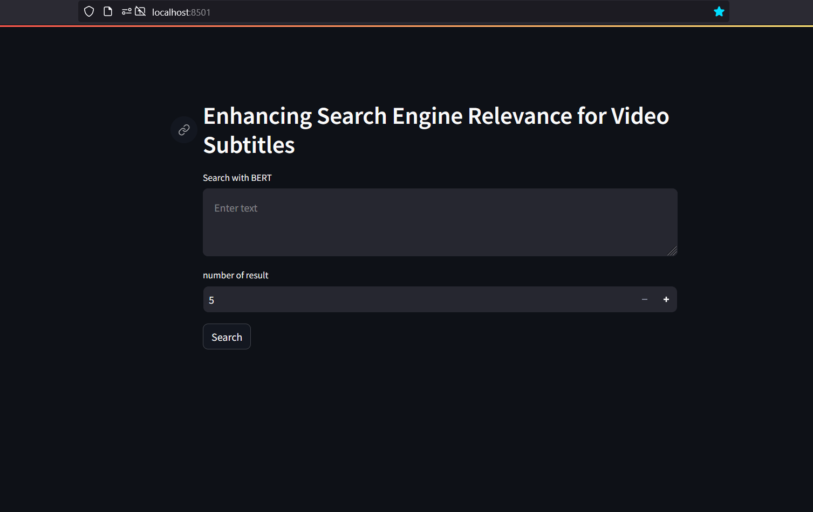
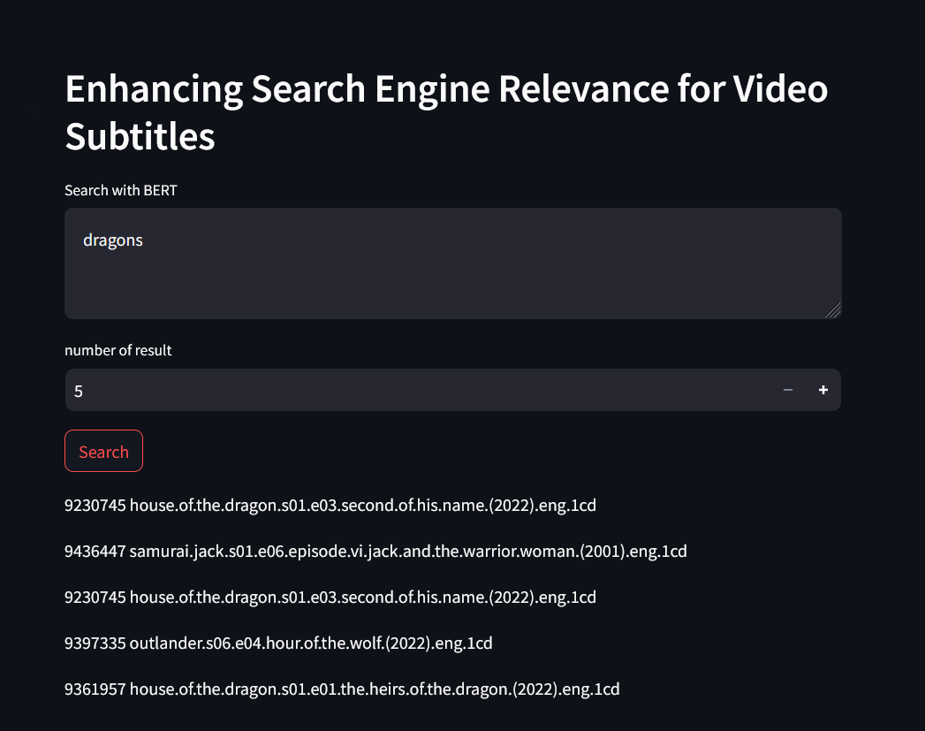
Search Engine over view Search Results

Slide 8
Step by Step Process - Part 2:
Document Retrieval:
Here, we explain how we create query embeddings and calculate cosine similarity scores to retrieve the most relevant documents.
Example:
You search for "best comedy moments," and our engine fetches hilarious scenes from a variety of films.
Insight:
By leveraging advanced AI techniques, we deliver personalized and accurate search results, enriching the user experience.

Slide 9

THANK YOU !

